Slide 1
What effects how residents of NH value local Forests?
Chris LaRosee

Slide 2
ES Valuation

Slide 3
ES Valuation
Ecosystem Services
The direct and indirect benefits to humans from the environment

Slide 4
ES Valuation
Typically involves
Asking residents how much money would be enough to compensate for the loss of an ecosystem service

Slide 5
ES Valuation
Typically involves
Asking residents how much money would be enough to compensate for the loss of an ecosystem service
BOOM!
$ value
Fits within our economic framework neatly

Slide 6
ES Valuation
Problems

Slide 7
ES Valuation
Problems
Many ecosystem services are not replaceable
Income subjectivity
Self-interests > Community-interests

Slide 8
ES Valuation
Problems
Many ecosystem services are not replaceable
Income subjectivity
Self-interests > Community-interests
Solutions
Subjective by Nature
Deliberative Workshops
Common good
Likert
Income-independent

Slide 9
ES Valuation: This Study
Survey
Likert Values for 11 ecosystem service
Demographic Qs

Slide 10
ES Valuation: This Study
Survey
Likert Values for 11 ecosystem service
Demographic Qs
Original Purpose
Workshop recruitment

Slide 11
ES Valuation: This Study
Examines three ES provided by local forests (S. NH)
Wood (Provisioning)
Fall Foliage (Cultural)
Climate Regulation (Regulating)
Biodiversity (Supporting)

Slide 12
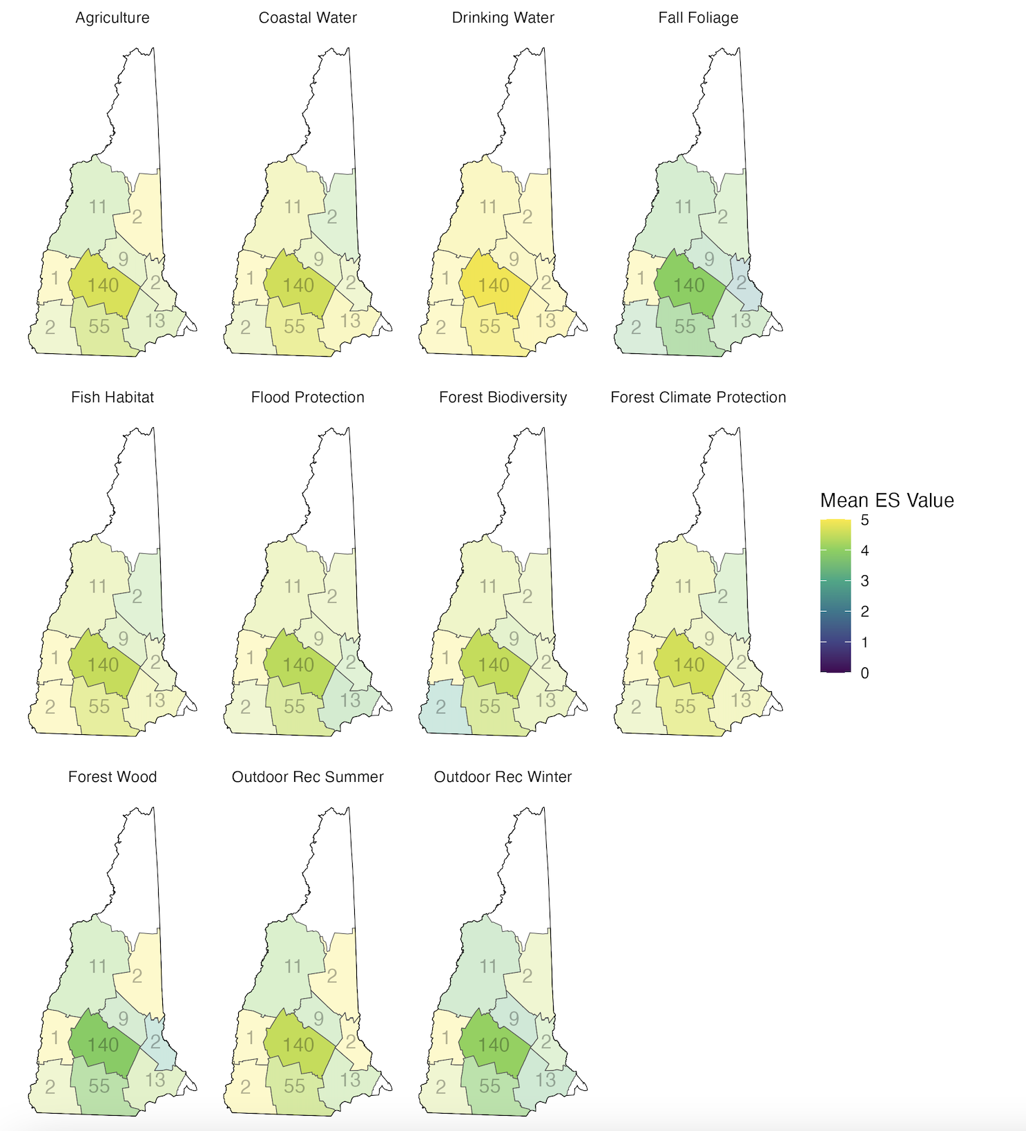

Slide 13
Methods
Mann-Whitney U
Do Men respond differently than Women?

Slide 14
Methods
Mann-Whitney U
Do Men value the services differently than Women?
Ordinal Logistic Regression
Do demographic parameters influence service valuation?

Slide 15
Results: This Study
Predictors Examined
Age
Wood
Gender
Political Views
Climate Protection
Biodiversity (almost)
Education
Race
Income
Ranking of Environmental Quality

Slide 16
Results: This Study
Predictors Examined
Age
Wood (p = 0.0175)
Political Views
Climate Protection (p = 0.0892)
Biodiversity (p = 0.0153)

Slide 17
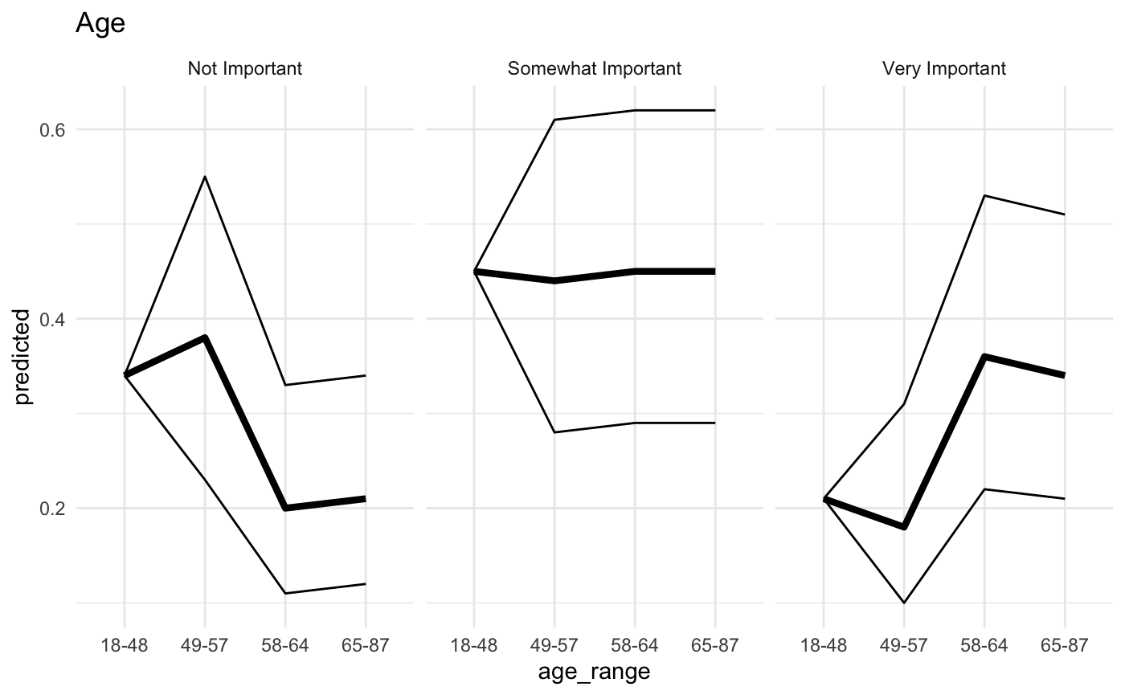
Results: This Study
Predictors Examined
Age
Wood (p = 0.0175)
Political Views
Climate Protection (p = 0.0892)
Biodiversity (p = 0.0153)

Slide 18
Limitations + Future

